Slide 1
Meta skills in Modern Apprenticeships Community of Practice
5 December 2024

Slide 2
Introduction
Purpose
To share approaches to delivering and evidencing meta skills to maximise the impact of the overall apprenticeship experience for our apprentices
Objectives
By the end of the session, Providers will have:
improved clarity on the expectations for delivery, assessment and evidencing of meta skills
benefitted from opportunities to share practices, tips and challenges
reflected on the insights gained and considered improvement actions or enhancements they may wish to take forward as a result

Slide 3
Agenda
Item | Timings
Introduction, Purpose and objectives | 10.30 – 10.40
Meta skills and their role within apprenticeships Delivering and evidencing meta skills in apprenticeships Developing and progressing meta skills Q and A | 10.40 – 11.40
Workshop activity | 11.40 – 13.00
Lunch Tour of GTG training workshop | 13.00 – 14.30
Summary of feedback from workshop activity | 14.30 – 14.50
Powering Futures – case study of work with an employer in apprenticeships | 14.50 – 15.05
Reflection and event feedback | 15.05 – 15.20
Closing remarks and next steps | 15.20 – 15.30

Slide 4
A little inspiration…..

Slide 5
Meta skills and their role within apprenticeships
Karen Murray, Head of Work-based Learning Quality Delivery, Skills Development Scotland
Marisa Farrell, Policy and Research Analyst, Scottish Qualifications Authority
Peter Connelly, HMIE, Lead Inspector of Education, Education Scotland

Slide 6
Meta Skills and their role within the apprenticeship
Meta-skills principles – meta skills are:
Consciously developed through reflection
Able to be described by a learner
Able to be applied across different work and learning contexts
Developed through activities and experiences
Considered unique to every individual depending on their life and work experience(s)
Integrated in activities but not so deeply embedded they aren’t recognised
Developed in the round, not individually
Title

Slide 7
Learning Provider’s role in apprentices’ meta skills journey
Learning Providers should:
Support apprentices to self reflect on the strengths and areas for development at the beginning of their apprenticeship
Help apprentices to become self aware of their own meta skills using appropriate language for each individual apprentice
Support apprentices to identify opportunities in the workplace/in their apprenticeship to develop meta skills
Support employers in their role in identifying opportunities to develop and evidence their employee apprentices’ meta skills
Support and facilitate apprentices to evidence reflection on their own meta skills development and finally at the end of their apprenticeship
Ensure the evidence built by the apprentice meets the requirements of the unit specification(where relevant).
Title

Slide 8
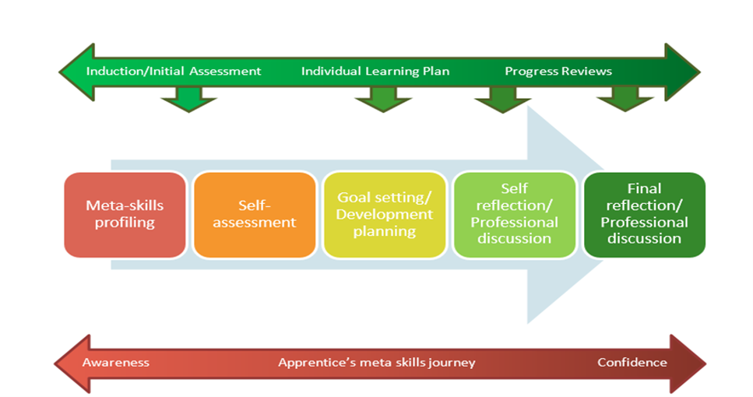
Meta Skills and their role within the apprenticeship

Slide 10
Knowledge and understanding
Plan
Do
Review
Growing awareness of meta-skills, their purpose and importance, and how they relate to own work.
Identify learning preferences, gaps in role specific knowledge, skills and meta-skills and understanding of how to develop these -- with a growing degree of autonomy.
Growing confidence and effectiveness when participating in performance reviews.
Growing understanding of the relationship between CPD and an organisation’s key performance indicators.
Growing confidence and aptitude for setting and using SMART objectives, with increasing autonomy.
Understanding the importance of business and personal objectives in own development with increasing focus on the preparation of development plans.
Increasing understanding of personal professionalism within current work contexts and practices.
Types of training and development required for own role

Slide 11
Plan | SCQF level 5 | SCQF level 6 | SCQF level 7 | SCQF level 8
Baseline self-assessment | Identifying (with support) meta-skills and role-specific skills for own work and completing self-assessments of own strengths and improvement needs for personal practice. | Identifying meta-skills and role specific skills regularly used in own work to assess strengths and improvement needs for personal and professional development. | Self-evaluating meta-skills and role-specific skills regularly to assess strengths and improvement needs for personal and professional development. | Self-evaluating meta-skills regularly to identify own strengths and improvement needs for personal and professional development.
Goals | Discussing and agreeing straightforward SMART objectives for personal development and to achieve work plans. | Discussing and agreeing SMART objectives for personal and professional development and to achieve business objectives. | Setting and agreeing SMART objectives for personal and professional development and to achieve business objectives. | Setting SMART objectives for personal and professional development and to achieve business objectives.
Plan | Discussing and agreeing straightforward training and development activities required to improve own performance and to achieve work plans. | Discussing and agreeing training and development activities required to improve own performance and to achieve business objectives. | Planning and arranging training and development activities to improve own performance and to achieve business objectives. | Planning and evaluating training and development activities to improve own performance and to achieve business objectives.

Slide 12
Do | SCQF level 5 | SCQF level 6 | SCQF level 7 | SCQF level 8
Do | Completing straightforward training and development activities within agreed timescales with support to progress own performance. | Completing training and development activities within agreed timescales to support and progress own performance. | Completing formal and informal training and development activities within agreed timescales to support and progress own development. | Completing formal and informal training and development activities within set timescales to support and progress own development
Training | Completing straightforward mandatory role related training in line with organisational requirements. | Completing mandatory role related training in line with organisational requirements. | Completing mandatory role related training in line with organisational requirements. | Completing mandatory role related training in line with organisational requirements.
Recording | Completing straightforward documentation required for personal development in line with organisation policy and procedures. | Completing documentation required for personal development and practice in line with organisation policy and procedures. | Completing and maintaining personal and professional development records and documents in line with organisational policy and procedures. | Completing and maintaining personal and professional development records and documents in line with organisational policy and procedures.

Slide 13
Review | SCQF level 5 | SCQF level 6 | SCQF level 7 | SCQF level 8
Feedback | Acting on feedback and support to improve own performance. | Acting on feedback to improve own performance and development. | Seeking and acting on feedback to improve own performance and development. | Seeking and acting on feedback to improve own performance and development.
Reflect | Review (with support) progress in meta-skills and role-specific skills to agree future development needs. | Reflecting on performance, meta-skills and specific skills developed in your role to identify and agree future development needs. | Reflecting in detail on own performance and involvement in activities to support own development and achievement. | Critically reflecting on own performance and involvement in activities to support own development and achievement.
Evaluate | NIL | Evaluating meta-skills and role specific skills developed in your role to identify and agree future development needs. | Evaluating in detail the development and application of meta-skills in own work to identify future development needs. | Critically evaluating the development and application of meta-skills in own work to identify future development needs.

Slide 14
UNIT OUTCOME Comparing experience and expectations across levels | SCQF level 5 | SCQF level 6 | SCQF level 7 | SCQF level 8
 | Develop meta-skills and personal practice |  | Develop meta-skills and professional practice
 | Self-evaluation |  |  | Critical evaluation
 | Agreeing objectives |  | Agreeing and setting objectives | Goal-setting and active learning
 | Reviewing progress | Reflecting on practice | Reflective practice (seeking feedback)
 | Improve performance in line with organisational requirements (growing degree of autonomy and individual responsibility)
 | Working towards development objectives (growing focus on CPD and managing wellbeing)
 | High level of ongoing support | Support | Some support | Largely autonomous, self-managing

Slide 15
Meta Skills Resources
Work-based Learning Quality Assurance and Improvement Hub has lots of useful resources specific to MA Providers, including guidance and recording templates, profiling and self-assessment tools, sector videos, effective practice (CoPs)
SDS Meta skills toolkit aimed at schools but has lots of useful resources, posters, self-evaluation wheels, self-reflection workbook that you can use/adapt for apprentices
SDS E- Learning module
SQA E Learning Modules
Introducing, understanding and developing meta skills
Title

Slide 16
Developing and progressing meta skills in MA programmes
Peter Connelly
HM Inspector of Education

Slide 17
OECD Paper Knowledge for 2030
“The concept of competency implies more than just the acquisition of knowledge and skills; it involves the mobilisation of knowledge, skills, attitudes and values in a range of specific contexts to meet complex demands.”

Slide 18
The WHY? Contractual basis Framework basis or WHAT?

Slide 19
What we find on review?

Slide 20
Examples of QIs from HMIE MA Quality framework
Leadership and Quality culture:
Outcomes and experiences of apprentices
Enhancement of planning and provision
Impact of self evaluation and action for improvement
Service Delivery:
Planning and preparation of high-quality delivery
Promotion of independence and development of skills
Links between training and employers and sectoral needs
Employer and MA satisfaction with programme

Slide 21
Questions we cover on review
How do meta skills and personal attributes fit into the training programme? Do apprentices understand their importance, and are they incorporated as an integral part of the programme?
The Training Plan contains learning objectives which may be qualification related, work related or a personal objective. It should be reviewed regularly and updated, with objectives closed off and any new objectives added as the qualification progresses. How effective is this process in setting and achieving milestones in MA training?

Slide 23
Advice from HMIE
Be creative – which meta skills are more important for your employers and apprentices.
Own it and be bold – implement plans to develop these skills.
Your judgment is robust, accurate, based on sound evidence.
Your apprentices and employers can play a part.
Helicopter view/Overview – what have we produced?
Do things differently, not do different things!

Slide 24
For example: Adaptability skills
Being able to adapt means you are ready to cope with change. You respond positively and constructively to new ideas and experiences and to unexpected challenges. You think about this and learn from it all, building your understanding of how things work.

Slide 25
Adaptability: Working with the apprentice
Set clear objectives and define clear goals.
Set adaptability skills through practical tasks in daily work.
Reflect on progress and identify areas for growth.
Create a progression plan to propel their development forward.

Slide 26
Adaptability skills: Capturing evidence
Reflective Journal
What?
So What?
Now What?

Slide 27
Example: The How
Set an agreed time to reflect on progress made and consider next steps.
Reflect on past challenges
Analyse recent situations where you adapted and identify key learning.
Seek feedback
Request specific input from peers and managers on your adaptability skills.
Set New Learning Goals
Use AI

Slide 28
Resources: Adaptability skills
sqaacademy.org.uk/mod/scorm/player.php?a=720&currentorg=articulate_rise&scoid=2291&sesskey=tikiu3omF7&display=popup&mode=normal
1451_skills-toolkit-phase-1-_guidance-paper_v4-002-final.pdf (stf.org.uk)
meta-skills-progression-framework.pdf (skillsdevelopmentscotland.co.uk)

Slide 29
Workshop discussion
Purpose
To share approaches to delivering and evidencing meta skills to maximise the impact of the overall apprenticeship experience for our apprentices
Questions
How do you help apprentices to buy in to meta-skills and understand their relevance?
How and where do meta-skills fit most naturally in your apprenticeship delivery?
How are you generating assessment evidence?
Output
Share your tips and any challenges

Slide 30
We prepare the workforce of the future for the jobs of the future by unlocking their potential and finding their hidden talent
Engaging one million young people by 2030

Slide 31
Whether in workplace or in school young people, age 16 - 25, solve real industry sustainability challenges and pitch them to a panel of judges.
They develop META skills; problem-solving, resilience and critical thinking and gain knowledge and understanding of sustainability itself.
Participants gain experience and a qualification that they can use in their next steps in work or beyond school.
EDUCATION
PROGRAMMES
ALUMNI AND VOLUNTEERS
WORKPLACE
CHALLENGE

Slide 32
Workplace
Bespoke Challenge
14 week CPD accredited programme, creating
a business case pitch for senior leaders
Target audience age 16-25
Blended learning, in person and online
Generates evidence for VQ portfolio and
maps fully to core skills
Develop META skills, that increase
productivity & time to value in role

Slide 33
Case Study
Scottish Water aimed to build confidence, develop META- skills and foster strong working relationships.
Apprentices tackled real sustainability challenges
Alternative power sources for backup generators.
Powering remote telemetry sites.
Measuring water without domestic water aids.
Outcomes:
Enhanced skills for future work, creating a confident and efficient workforce.
Personal growth in presentation, teamworking, and communication.
Improved understanding of the business and its functions.

Slide 34
Case Study
Lothian aimed to develop the confidence, understanding and skill set of their young workforce
Apprentices addressed real sustainability issues:
Setting up a local combined heat and power generator.
Exploring biogas as a potential power source.
Outcomes:
Improved Working Relationships: Developed stronger connections through engaging in-person sessions.
Enhanced Problem-Solving: Built skills in solution development, data presentation, cost analysis, and adapting to challenges.

Slide 35
Secondary Schools
SCQF Level 6 Accredited Programme
80 notional learning hours delivered across the academic year
8 SCQF credit points, 7 UCAS tariff points
37 Insight Data points, breadth and depth
Target audience S5/6
No cost for schools to
implement
Fully developed high quality resources

Slide 36
WE ASKED OUR DELIVERY TEACHERS WHAT THEY THOUGHT OF THE PROGRAMME...
98%
OF OUR DELIVERY TEACHERS AGREE THAT
The programme can be delivered by any teacher from any faculty.
Our resources are easy to use.
The programme evidences outcomes related to Learning for Sustainability.

Slide 37
IMPACT
47%
male
53%
female
Teachers Trained
225
91685
Total Participant Hours
Volunteer Hours
120
3776
180
partners
schools
29/32
Local Authorities
772
4872
Figures as of Nov 24
195
Teams
participants
CPD hours

Slide 38
Trusted by
We are trusted by industry leaders, as well as emerging, agile organisations who are passionate about developing future talent, driving sustainability and building great workplaces.

Slide 39
Engaging one million young people by 2030

Slide 40
Closing remarks and next steps

