Slide 1
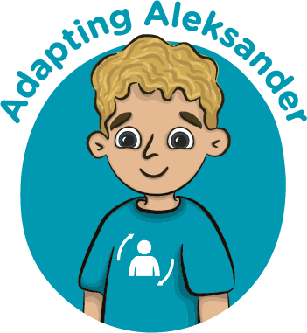
Meta Skills Land character icons
Self-management
Social intelligence
Innovation
Focusing
Communicating
Curiosity
Integrity
Feeling
Sense-making
Adapting
Collaborating
Creativity
Initiative
Leading
Critical thinking

